Slide 1
Safer internet for girls
Facilitator: Sushil Phuyal
(Security Analyst)
Cynical Technology

Slide 2

Who am I?
A security analyst currently employed by cynical technology who is certified as
Cisco Cyberops, Network security associate 1-3, CSFPC, IC2 certifications, and many others.

Slide 3

What is Security?

Slide 4

CIA Triad

Slide 5
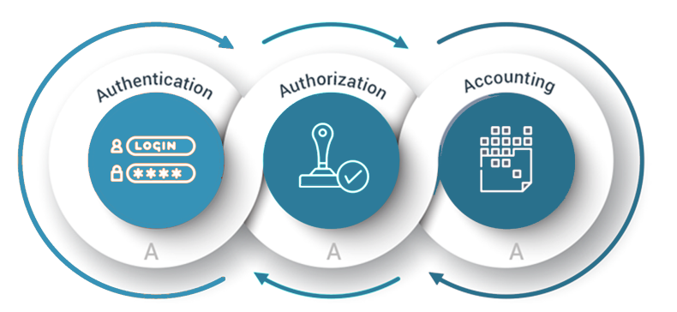
AAA: Authentication, Authorization and Accounting

Slide 6

What is hacking?
Unauthorized access to network or system.
Exploiting misconfiguration, security controls or vulnerable services.
Contains more illusions than facts.
“If something looks like spell in today’s world, then it’s exploit”

Slide 7
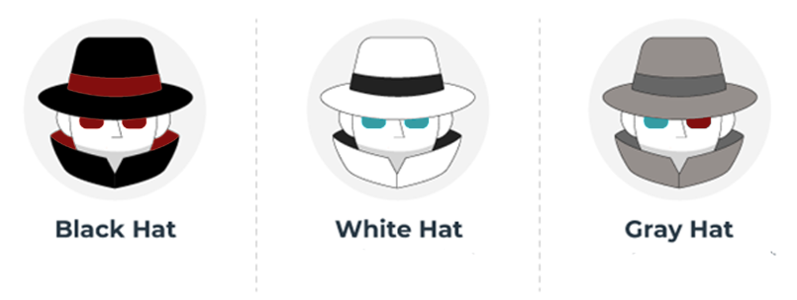
Types of hacker

Slide 8

Why Linux?
Open Source
Good Terminal Environment
Supreme Control of Privilege
Perfect control through CLI
More than 90% web servers uses Linux

Slide 9

Threat actor
Social Engineering: Phishing, Vishing, Scam
Spoofing: DNS and Mail
Weak Password
Malware and Ransomware
Your follower is not always your fan

Slide 10

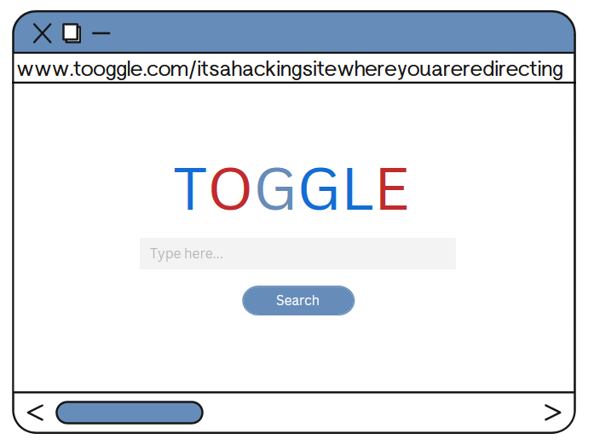

Social Engineering
Phishing attack: Similar looking sites to trap a victim
Vishing: Audio form of phishing
Scam: Cheat someone using various methodologies to gain something

Slide 11
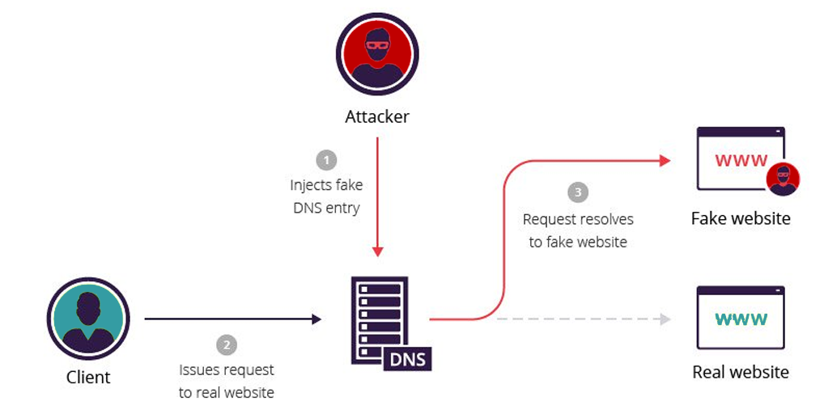

Spoofing
DNS Spoofing: Common attack on public Wi-Fi.
Mail Spoofing: Altered mail from the mail servers.

Slide 12
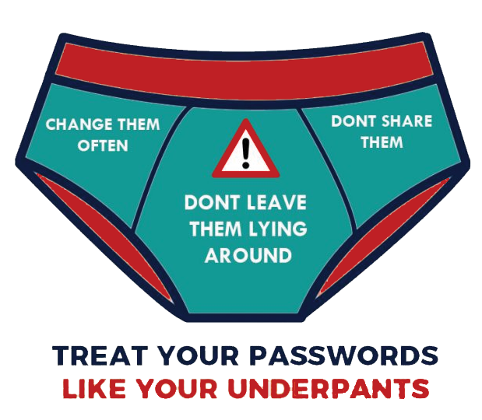
Weak Password

Slide 13
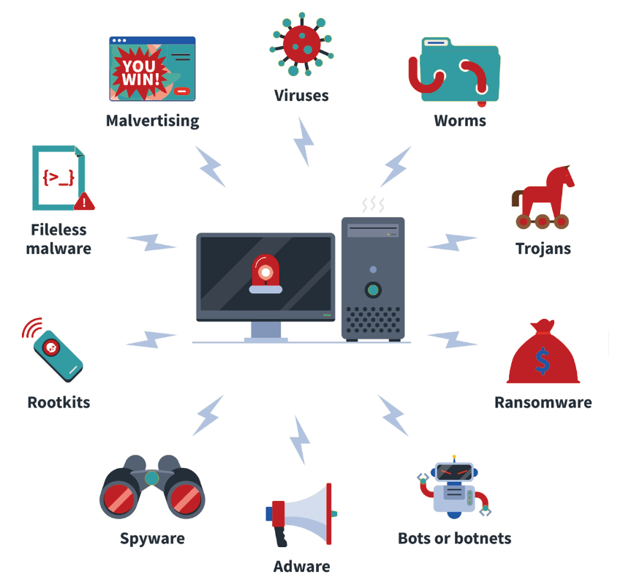
Malware

Slide 14
Taste of Offensive security
Image Forensics
Web Inspection
Google Hacking
Cryptography
Password Spraying
Open-Source Intelligence (OSINT)
Insecure Direct Object Reference (IDOR)
Open Redirect
Cross site scripting (XSS)

Slide 15

Image Forensics
Image science is a branch of digital forensics that studies image artifacts such as properties, metadata, and other informational assets.

Slide 16

Web Inspection
The inspect element is a modern web browser feature that allows anyone to view and edit the source code of a website, including its HTML, CSS, JavaScript, and media files.

Slide 17
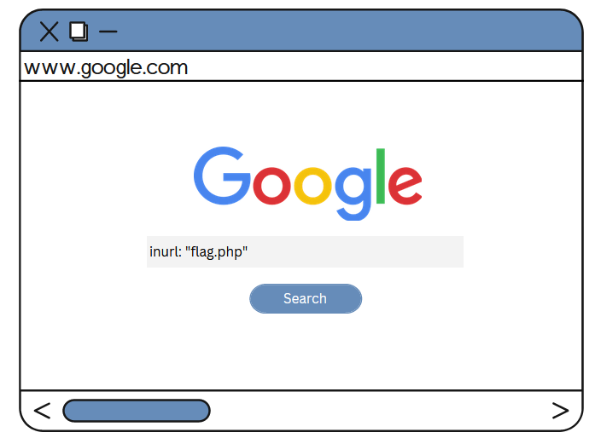
Google Hacking
Google hacking, also known as Google dorking, is a hacker technique that employs Google Search and other Google applications to identify security flaws in website configuration and computer code.

Slide 18
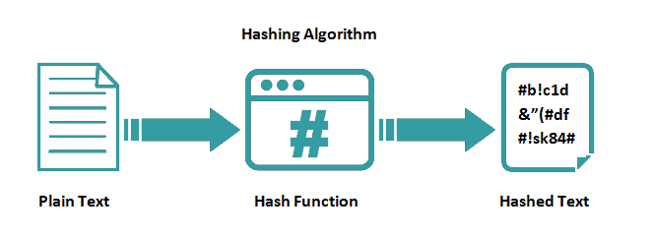
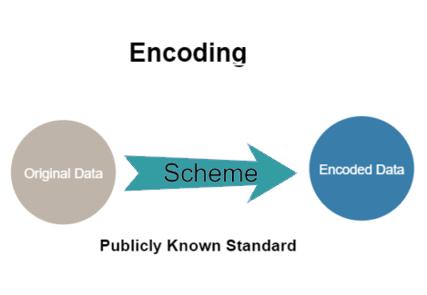
Cryptography: Hashing and Encoding
Hashing is the process of converting one value into another based on a given key or string of characters.
While Encoding data is the process of converting data into a new format by employing a scheme. Data can be encoded to a new format and decoded back to its original format because encoding is a reversible process.

Slide 19
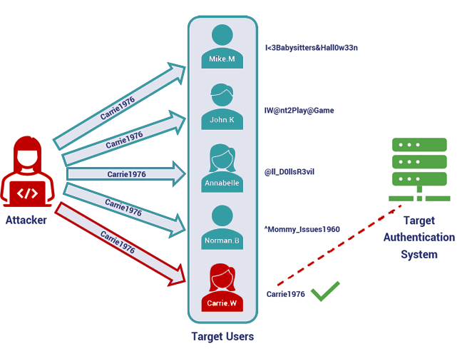
Password Spraying
A password spraying attack is a type of brute force attack. A traditional brute force attack involves the perpetrator attempting to gain unauthorized access to a single account by repeatedly guessing the password.

Slide 20
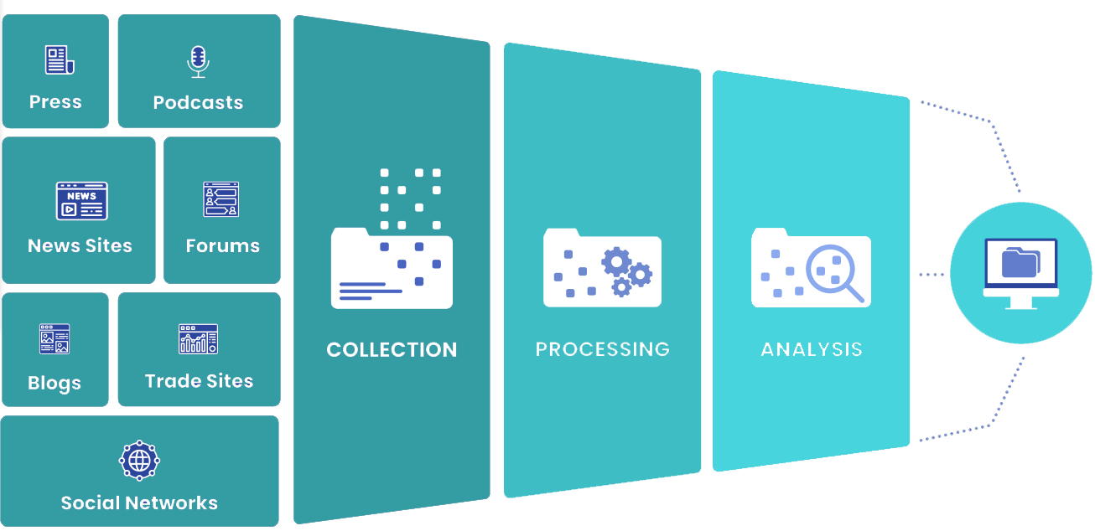
Open-Source Intelligence (OSINT)
The collection and analysis of data gathered from open sources (overt and publicly available sources) to produce actionable intelligence is known as open-source intelligence (OSINT).

Slide 21
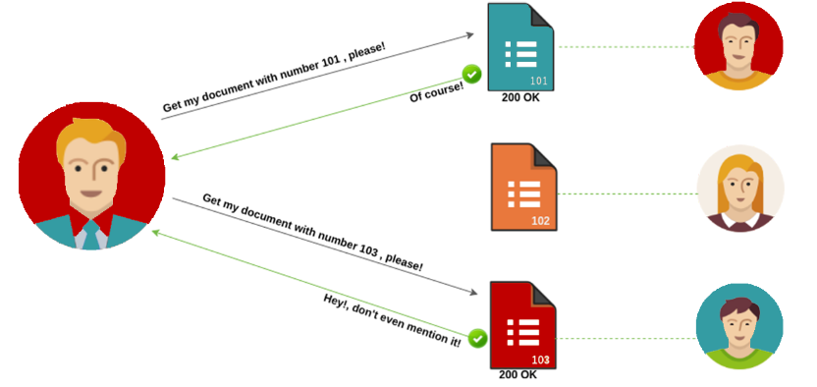
Insecure Direct Object Reference (IDOR)
Insecure direct object references (IDOR) are a type of access control vulnerability that occurs when an application directly accesses objects using user-supplied input. It is, however, just one of many access control implementation errors that can lead to access controls being circumvented.

Slide 22
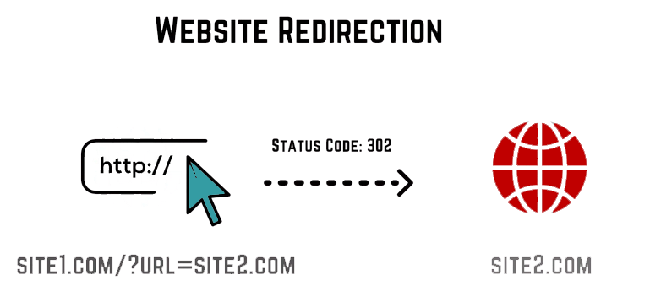
Open Redirect
When an application allows a user to control a redirect or forward to another URL, an open redirect vulnerability exists.
If the app does not validate untrusted user input, an attacker could provide a URL that redirects a victim from a legitimate domain to an attacker's phishing site.

Slide 23
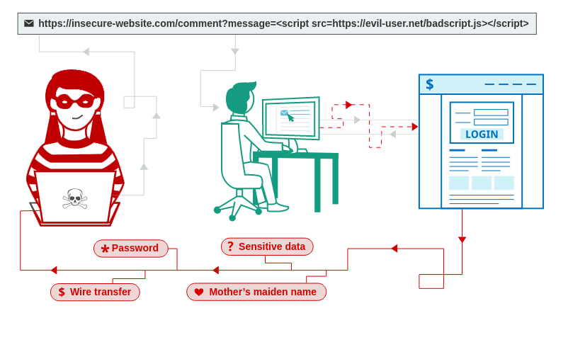
Cross Site Scripting (XSS)
Cross-site scripting (XSS) is a type of security flaw found in some web applications. XSS attacks allow attackers to inject client-side scripts into web pages that other users are viewing. Attackers may exploit a cross-site scripting vulnerability to circumvent access controls such as the same-origin policy.

Slide 24
Thank You!
Any Questions?

